Slide 1
Devi Ahilya Vishwavidyalaya, Indore
School of Library and Information Science Central Library
Presentation to NAAC Peer Team
15-17th January, 2014

Slide 2
About “School of Library and Information Science”
Part- Time
B. L. I. Sc. 1993-94
Regular B. L. I. Sc. and M. L. I. Sc. 2006
M. Phil 2009-10
Established in the year 1993-94
Ph. D. Upcoming

Slide 3
Vision and Mission
Vision
To produce highly competent top class library professional, who are professionally competent, environmentally and socially conscious, ethical and with a motto to serve the society .
To produce the professional to meet the challenges of the libraries in the information technology dominated era. Professional who work for the profession.
Mission

Slide 4
Aims & Objectives
To acquaint the students with the growth and development of universe of knowledge, elements of librarianship and knowledge management.
To acquaint with the latest tools and techniques in information handling.
To train the students in library organization in an ICT era.

Slide 5
Academic Programs & Employability
B.L.I.S.
M.L.I.S.
M. Phil.
Classifier, Cataloguer, Library Assistant in University Level Library. Govt. jobs of Librarian in NVS and KVS.
Library Scientist, Information Scientist, SLIA. Govt. jobs. University, College, School and Public libraries
Assistant Librarian, Research Consultant, LIS Teacher, LIS Scientist. Govt. jobs. University, College, School, Special and Public libraries

Slide 6
Current Manpower Strength
Name | Qualifications | Experience Teaching | Experience Research | Experience Industry | Publications
Dr. GHS Naidu | B. Sc., M. A., M. L. I. Sc., Ph.D., Dip. A. Ed, Dip. L. S. G. | 20 Years | 20 Years | 20 Years | 50
Mr. B. Ratha | B.A., M. L. I. Sc., M. Phil, UGC-NET (Twice) | 6 Years | 6 Years | 1 Years | 8
Mrs. Swati Soni | B.A., M. L. I. Sc., M. Phil, UGC-NET (JRF), Ph. D. (Pursuing) | 2 Years | 2 Years | 3Years | 1

Slide 7
Students (40)(Academic Session: 2013-14)
 | B. L. I. Sc. |  |  |  | M. L. I. Sc. |  |  |  | M. Phil. |  |  |  | Total
Gender | M |  | F |  | M |  | F |  | M |  | F |  | M |  | F
Urban / Rural | U | R | U | R | U | R | U | R | U | R | U | R | U | R | U | R
From the state where the university is located | 0 | 1 | 8 | 1 | 2 | 0 | 17 | 0 | 0 | 2 | 4 | 1 | 2 | 3 | 29 | 2
From other states of India | 0 | 0 | 2 | 0 | 0 | 0 | 1 | 0 | 0 | 1 | 0 | 0 | 0 | 1 | 3 | 0
Total | 0 | 1 | 10 | 1 | 2 | 0 | 18 | 0 | 0 | 3 | 4 | 1 | 2 | 4 | 32 | 2
Grand Total | 12 |  |  |  | 20 |  |  |  | 08 |  |  |  | 40

Slide 8
Research, Projects and Publications from 2009-13
Name | Journal | Conference | Total
Dr. GHS Naidu | 02 | 05 | 07
Mr. Bhupendra Ratha | 05 | 03 | 08
Mrs. Swati Soni | - | 01 | 01
Ms. Arti Joshi | - | 01 | 01
M. Phil. Research Projects from 2009-13
Name of Guide | 2009-10 | 2010-11 | 2011-12 | 2012-13 | Total
Dr. GHS Naidu | 5 | 4 | 0 | 2 | 11
Dr. Kishor John | 3 | 5 | 2 | 4 | 14
Mrs. Preeti Patel | 5 | 4 | 0 | 0 | 09
Mr. Bhupendra Ratha | 5 | 3 | 4 | 0 | 12
Ms. Arti Joshi | 0 | 0 | 4 | 0 | 04
Total | 18 | 16 | 10 | 06 | 50

Slide 9
Publication in Journals
2013
Ratha, Bhupendra and Silawat, Ravi. “Use study of Newspapers in the Central Library of Devi Ahilya University”. Published in SRELS for publishing in Vol. 50(1), Feb. 2013 issue. (ISSN.0972-2467).
Joshi,Arti, Mukati ,Prakash and Naidu, GHS. “Internet Awareness among Students of Government Colleges of Indore City: A Study”. International Research: Journal of Library & Information Science. Vol.3 No.3, Sep. 2013
2012
Ratha, Bhupendra and Gawde, Manisha. “Information Research: an International Electronic Journal: A Bibliometric Study”. Published in IJODLIS. Vol. 2 Jan-March, 2012 Issue-1. (ISSN:2250-1142)
Ratha, Bhupendra, Naidu, GHS and Joshi, Leena. “Webometric Study of IITs Library Websites”. DESIDOC Journal of Library & Information Technology Vol. 32, No. 3, May 2012, pp. 250-255 (ISSN 0976-4658).
Ratha, Bhupendra and Vyas Rashmi. “Use of Mobile Phones by LIS Students of Affiliated Institutes of DAVV”. International Research: Journal of Library and Information Science. Vol. 2 No. 1, June 2012 (ISSN 2249–0213).http://irjlis.com/use-mobile-phones-libraries/
Ratha, Bhupendra, Naidu, GHS and Hardiya, Maya. “Occupational Stress among the Library Professionals: Special Reference to Private Engineering College of Indore City”. Pearl: A Journal of Library and Information Science Vol.6, Issue-1. January-March 2012, (ISSN 0973-7081).

Slide 10
Publication in Conference Proceeding
2013
Naidu, GHS, Ratha, Bhupendra and Goyal, Mahesh Kumar. “Library professionals and MS-Office literacy”. Published in Conference Proceedings of CDLMCAO 2013 in Chhindwara (M.P.), pp. 06-10. (ISBN 978-93-82351-15-3).
2012
Joshi, Arti, Naidu, GHS and Kanungo, Vinita. “User satisfaction in medical college libraries of indore city”. Published in Conference Proceedings of ETTLIS 2012 in Guna (M.P.) (ISBN 81-907999-2-4).
Ratha, Bhupendra, Naidu, GHS and Muwel, Kamal Singh. “E-Learning among the LIS Students”. Published in Conference Proceedings of ETTLIS 2012 in Guna (M.P.), pp. 85-93. (ISBN 81-907999-2-4).
Ratha, Bhupendra, Naidu, GHS and Silawat, Ravi. “Web Analysis of National Libraries of SAARC Countries”. Published in edited book ICT Based Information Management in Indian Libraries. 2012. pp. 219-234. (ISBN 978-93-80574-33-2).
Patel, Preeti, and Naidu, GHS. “Challenge for IPR in Electronic Publishing Age: A Study of National and International Perspectives”. Published in conference proceedings of ICEP 2012, in Pondicherry.
Soni, Swati and Subhi "Cutting-edge Library Services Right Away Using Social Networking Tools”. (Paper Published) Published in conference proceedings of PLANNER 2012, in Sikkim.

Slide 11
Significant Achievements
Yearly Selection in NET
No. | Name of Student | Year of Success
01. | Ms. Nimita Kapoor | December 2012
02. | Mr. Upendra Singh Sudan | June 2012
03. | Mr. Manoj K. Choudhary | June 2012
04. | Ms. Megha Kushwah | December 2011
05. | Ms. Jyoti Devliya | June 2010
06. | Mr. Rakesh chouhan | June 2010
07. | Mr. Ravi Karan Sahu | June 2010
08. | Mrs. Chetna Anjana | December 2008
09. | Ms. Madhuri Panwar | December 2008

Slide 12
Curricular Aspects
Curriculum Design and Development
Yearly update the Curricular according to changing phenomena in the field.
Academic Flexibility
Elective paper In M. L. I. Sc. course.
Curriculum Enrichment
Remedial classes for slow learners
Extra Classes for Advance learners to ensure enrichment.
Curriculum Feedback System
Semester wise feedback are taken from the students, Alumni, Subject Expert.

Slide 13
Curriculum Feedback System (1st Sem. 2013)

Slide 14
Teaching –Learning and Evaluation
Student Enrolment and Profile: Admission Policy and Procedure
Advertisement for admission through University website, departmental web site, newspapers, pamphlets, flexes board etc.
All the details like admission procedure, eligibility, fees are available on the departmental website.
The admission in BLIS, MLIS and M Phil Courses on merit base through DET (Departmental Entrance Test).
Category | 2009-10 | 2010-11 | 2011-12 | 2012-13 | 2013-14 | Total
SC-M | 3 | 6 | 4 | 3 | 3 | 19
SC-F | 9 | 12 | 6 | 5 | 5 | 37
ST-M | 2 | 5 | 4 | 1 | 2 | 14
ST-F | 4 | 5 | 5 | 2 | 0 | 16
OBC-M | 8 | 8 | 7 | 5 | 1 | 29
OBC-F | 14 | 14 | 14 | 11 | 7 | 60
General-M | 4 | 5 | 0 | 1 | 0 | 10
General-F | 20 | 17 | 16 | 14 | 22 | 89
Total | 64 | 72 | 56 | 42 | 40 | 274

Slide 15
Catering of Diverse Needs of Students
Extra Classes for Advance learners to enrichment.
Enrichment Course Name | Topic | Date | Duration | No. of Students | Objectives and value of the Topic | Teacher’s Name
BLIS | Internet and e-resources | 26.12.2013 27.12.2013 28.12.2013 | 11-01 PM (2 Hours) | 6 | Objectives: To make an awareness of internet and e-resource. Value of Topic: The students cane the internet and e-resource for their study. | GHS Naidu
MLIS | Research and ICT | 26.12.2013 27.12.2013 28.12.2013 | 01.30 to 04.30 PM (2 Hours) | 15 | Objectives: To teach how the ICT apply in research. Value of Topic: The students can use ICT in their research and do their research easy, effective and qualitative. | Swati Soni
M Phil | Blogging | 26.12.2013 27.12.2013 28.12.2013 | 4-5.30 PM (1½ Hours) | 6 | Objectives: To encourage the M Phil students for contributing their ideas online. Value of Topic: The students can connect and make good relationship with LIS professions at the international level through blogging. | B. Ratha
Teaching Learning Process
Each paper in every course has a course plan
The smart classroom teaching
Poster group presentation
Academic and Motivational activities

Slide 16
Student Feedback on Teaching Learning process

Slide 17
Evaluation Process and Reforms
Steps for students Evaluation
All the faculty members, Head of the Department and external examiners evaluate the student’s performances.
The School conducts 3 Unit Test for each paper in each semester. The 1st and 2nd Unit test conduct as in the written form and the 3 Unit Test conducts as in the form of student’s seminar or poster presentation. The result of each Unit Test declares in the 1 week of ending the unit test.
The School conducts final exam and comprehensive viva voce for each semester. The results of first semester declared before 31 December and second semester before 25 May.
For the transparency of evaluation process, the answer books of all the unit test and final exam show in front of the students.

Slide 18
Student Performance and Learning Outcomes
Course | Learning outcome | Learning outcome Assessment Procedure | Learning outcome achieved
BLIS | Understand Library and Information Systems. Equipped with skills to manage computerized libraries | The learning outcome assess by different process like Unit Test, Seminar presentation Academic Activities Examination Teacher’s observation Observations of HOD and external examiners | After the assessment the assessment committee members are enucleated the 90% learning outcomes are achieved.
MLIS | Manage the libraries in the ICT environment. Able to scientifically communicate the research results with the peers.
M Phil | Manage the libraries of the 21st century in a digital environment. Inculcated with the ethics of research, statistical tools and techniques.

Slide 19
Research, Consultancy and Extension
Year Wise Dissertation of M. Phil
Year | Number of M. Phil. Dissertation awarded
2009-10 | 18
2010-11 | 18
2011-12 | 08
2012-13 | 06
Total | 50

Slide 20
Facilities for Research Work
Facility Location | Facilities
School/Institute Research Laboratory | Internet enabled computer lab with 5 computers.
ICT and Computer Facilities | Internet enabled computer lab with 5 computers.
School/Institute Research Library Printed books | Conference proceedings, Ph. D. Thesis of other LIS researchers, back volumes of LIS Journals etc.
Central Library Printed books | More than 400
E-Journals | 7 E-Journals Subscribing and More than 40 Open Access Journals of LIS are linked to the departmental website.
E-books | URL addresses of Open Access e-books are display in the course plan of each course.
Web-resources | The web resources related to the LIS field are available at the university website.
Databases | The databases related to the LIS field are available at the university website.

Slide 21
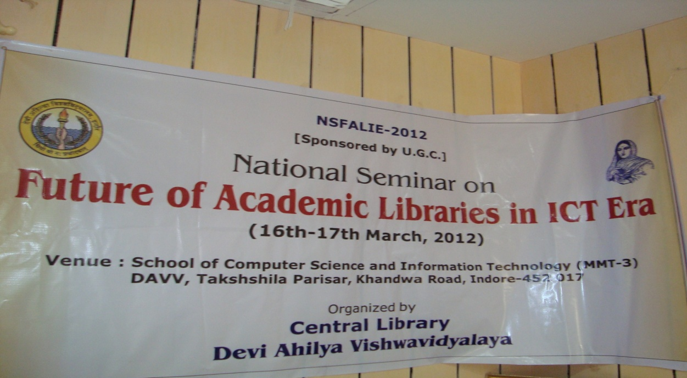
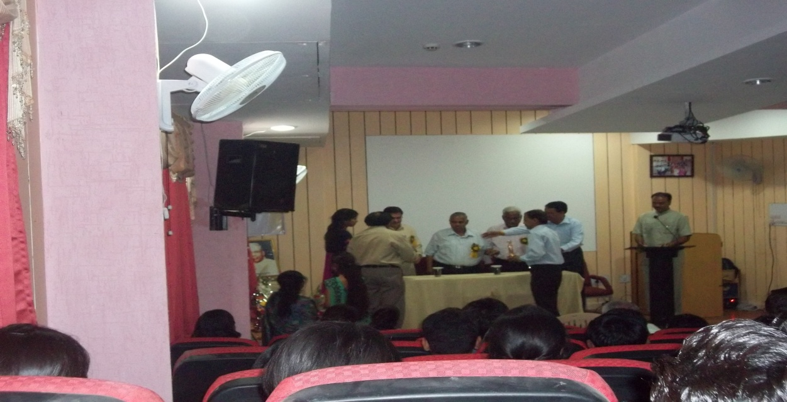
Extension Activities
The School of Library and Information Science has organized a “National conference on future of academic libraries in the ICT Era, 16-17 March, 2012”

Slide 22
Infrastructure and Learning Resources
Physical Facilities
Details of Department physical infrastructure
Building Space: 232.26 (in Sq meters) Faculty rooms 1/12.00
Class Rooms 2/173.00 Computer Lab 1/10.00
Common facilities 1/10.00 Library 1/ 9.26
Girls Common room 1/7.00 Office 1/ 11.00
First Aid Box is available in the Department. Health Center and day Care center Facilities are available in the campus

Slide 23
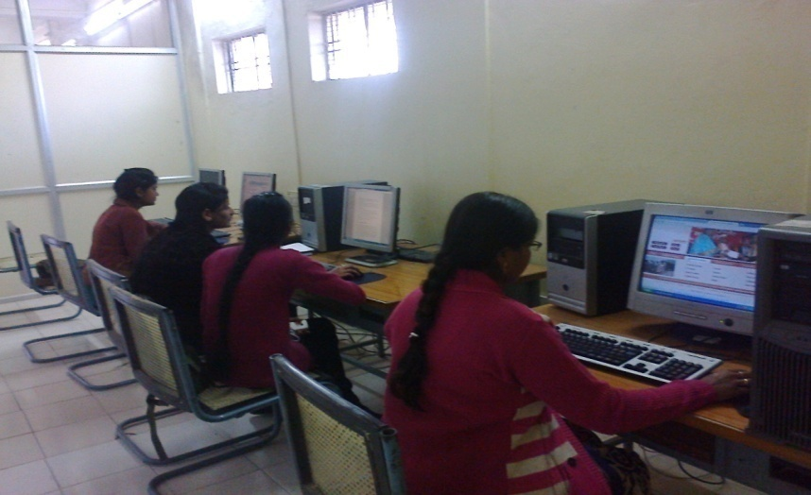
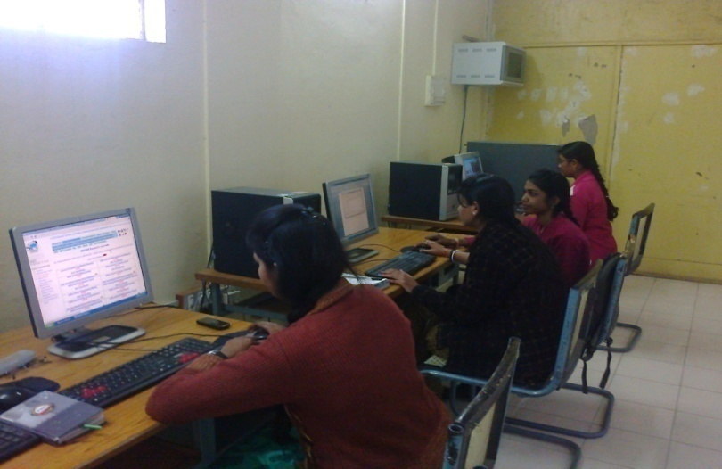
IT Infrastructure
A computer laboratory with . Internet and Wi-Fi Facilities.
Smart Class Rooms with ICT devices like LCD projector, Internet, Audio-Visual Aids etc.
Computerized Office automation.
Details of the computing facilities i.e., hardware and software. Each Desk top wiht1GB RAM, 320GB HDD, DVD drivers
Computer-student ratio 1:6
Available in closely linked IT Centre of the University
LAN facility Yes
Proprietary software TLSS
Number of nodes/ computers with internet facility 07

Slide 24
Library as a Learning Resource
Total area of the library (in Sq. Mts.) 9.3 Sq mts
Total seating capacity 10
Working hours 10:30AM to 5:30 PM
Layout of the library (individual reading carrels, lounge area for browsing and relaxed reading, IT zone for accessing e-resources)
Mode of access to collection Open Access System
Central Library is just adjacent to which access is available to each student.
Departmental library holdings: Print (books, back volumes and theses) Books: 462 Theses: 278
More than 40 E-Journals and 50 E-Lecturers are linked with the departmental website.
Electronic (e-books, e-journals):
http://www.dauniv.ac.in/ugcinfonet.php
Open access journals

Slide 25
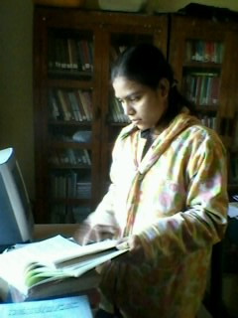
Library Website YES
In-house/remote access to e-publications YES
Library automation YES
Total number of computers for public access 05
Internet band width speed 1GBPS
Institutional Repository Planned in 2013-14
Participation in resource sharing networks/consortia (like INFLIBNET) YES
Details (per year) with regard to
Ratio of library books to students enrolled 1:5
Average number of books added during the last four years 50
Assistance in searching Databases YES
INFLIBNET/IUC facilities YES

Slide 26
Students Support and Progression
Student Mentoring and Support
Numbers of Students are less therefore the Course Coordinator is looking after the mentoring job. The Mentoring is done for Individual Student for academic, Social and career problems.
Every Saturday evening an informal meeting is being held in the Department
Students have access to career counsel and opportunity cell, language laboratory of the university. Computer skills are being learnt at IT Centre of the university.
Department publish its updated prospectus and handbook info annually on website and online access of course plans, syllabi and result http://www.clib.dauniv.ac.in/
Year | 2012-13 | 2011-12 | 2010-11 | 2009-10
Student Progression UG to PG | 50% | 52% | 65% | 82%
Student Progression PG to M. Phil. | 60% | 14% | 7% | 7%
Student Progression Employed • Campus selection | 30% | 30% | 30% | 30%
Student Progression Employed • Other than campus recruitment | 70% | 70% | 70% | 70%

Slide 27
Our Stars
The Students of Department are actively participating in sports and other extracurricular activities organized by university.
No. | Name of Alumni | Session | Position | Organization
01 | Navin Soni | 1996-97 | Scientist-B | DESIDOC
02 | Prashant Kumar | 1996-97 | Scientific Assistant | ARIES, Nainital
03 | Vilas Nimbalkar | 1997-98 | Sr. Tech. Assistant | IIM, Indore
04 | Raj Boria | 1999-2000 | Assistant Professor | Vikram Univ. Ujjain
05 | Ratan Kumar Jha | 2003-04 | Information Analyst | TERI, New Delhi
06 | Abhishek Gupta | 2010-11 | Sr. Tech. Assistant | IIM, Udaipur
07 | Ravikaran Sahu | 2010-11 | Sr. Tech. Assistant | DESIDOC
08 | Megha Kushwah | 2010-11 | Library Assistant | IIITDM, Jabalpur
09 | Satish Bisen | 2010-11 | Sr. Tech. Assistant | IIT, Indore
10 | L. R. Ahirwar | 2011-12 | Sr. Tech. Assistant | IIT, Indore

Slide 28
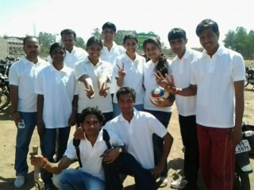
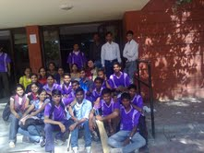
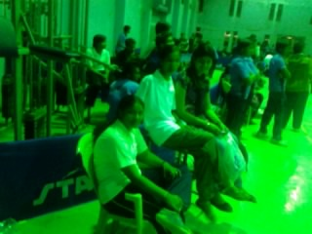
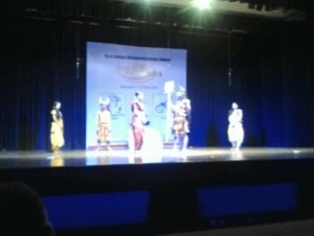
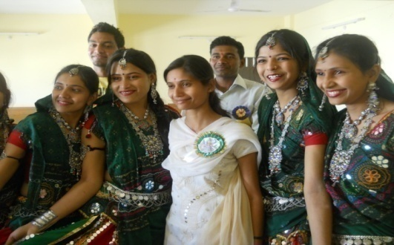
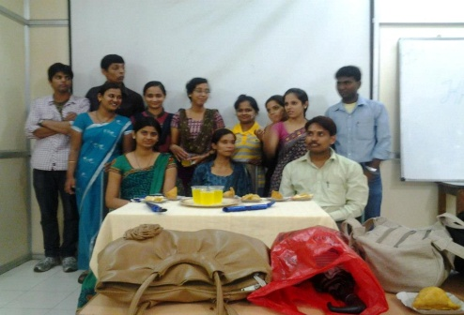
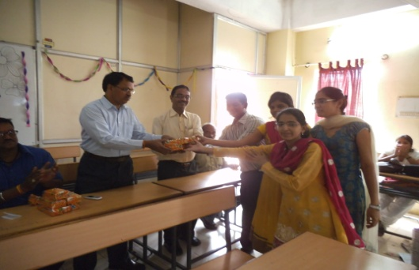
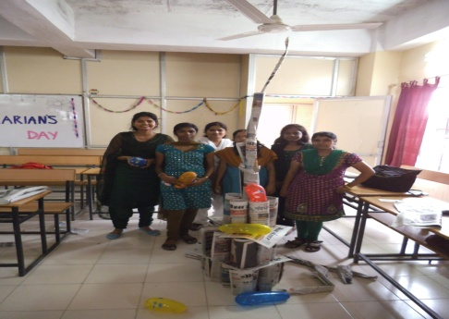
Students’ Participation and Activities
Volleyball Team: 2012-13
At Interdepartmental Activities
Cricket Team: 2012-13
At Interdepartmental Activities
Badminton Team: 2012-13
At Interdepartmental Activities
Skit Competition: 2012-13
At Interdepartmental Activities
Folk Dance : 2011-12
In the Alumni Meet
Teacher’s Day: 2012-13
In the department
Librarian’s Day: 2012-13
In the department
Academic Activities: 2012-13
In the department

Slide 29
Governance, Leadership and Management
Institutional Policies, Plans and Leadership
Organization at departmental level is Head, who is the Librarian of the University, Faculty members, and IV class employee.
Every issue is discussed in Departmental Committee and manage different situations.
A need assessment done prior to redesign syllabus, plan to procure equipments, furniture and major expenses.
Departmental Committee
Prof. K. N. Rajeshwari, SoM
Prof. Karmarkar, IIPS
Prof. Laxman Shinde, SoL
Dr. GHS Naidu, CL, SLIS
Student’s Evaluation and Monitoring Cell
Dr. GHS Naidu
Mr. Bhupendra Ratha
Ms. Swati Soni
Admission Cell
Dr. GHS Naidu, HOD
Mr. Bhupendra Ratha, Admt. In-charge
Strategy Development and Deployment
Anti-Ragging Cell
Dr. GHS Naidu,
Mr. B. Ratha, Mrs. S. Soni
B. Kumar, S. Rathore,
B. Edlabadkar
CDC
Dr. GHS Naidu
Mr. Bhupendra Ratha
Ms. Swati Soni
Ms. Anjali Patil
DRC
Prof. S. Kumar
Dr. GHS Naidu
Mr. B. Ratha
Ms. Swati Soni

Slide 30
Financial Management and Resource Mobilization
Statements of audited income and expenditure of academic and administrative activities of the last four years.
The Librarian is responsible for the overall development of SLIS, because the Department is functioning under the central Library. Every course is having a course coordinator. An IQAC cell with in the department is working. The team works with Head to maintain the quality and improve the weaknesses. It takes into account of performance, audit and feedbacks. It closely interacts with University IQAC.
Year | Income Source | Income(in Lakhs) | Expenditure(in Lakhs)
2012-13 | Self Finance | 11.80 | 11.30
2011-12 | Self Finance | 16.29 | 14.06
2010-11 | Self Finance | 16.66 | 13.04
2009-10 | Self Finance | 09.35 | 08.48
IQAC

Slide 31
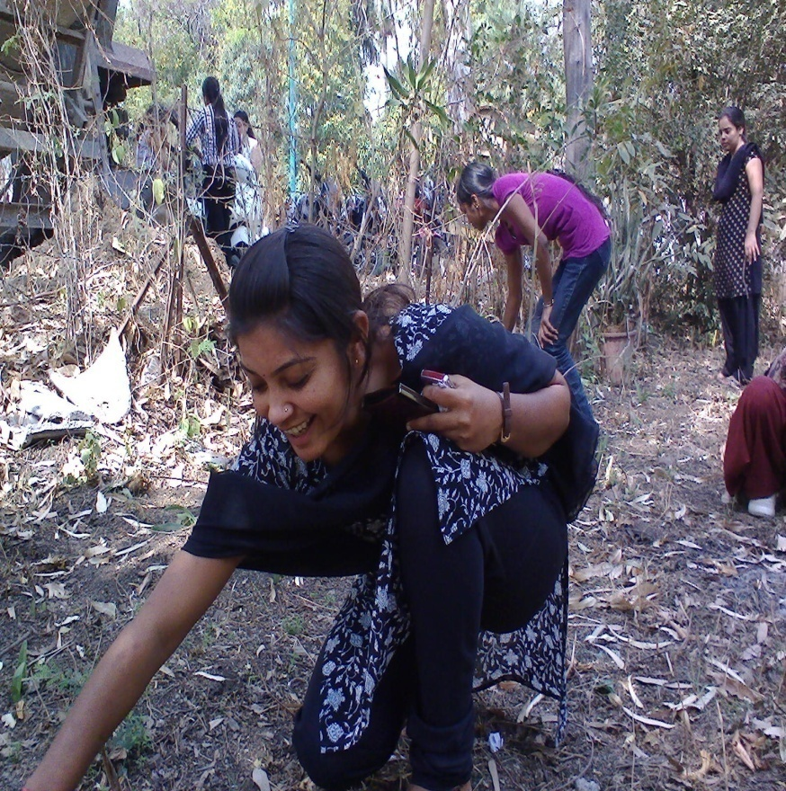
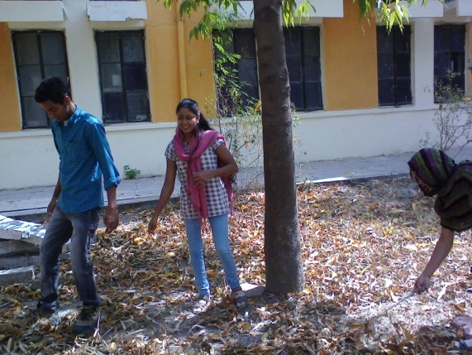
Innovations and Best Practices
Environment Consciousness
Departmental initiative to make the campus eco-friendly
Energy conservation Yes CFLs are used in place of bulbs
Use of renewable energy Solar Power plant planned for library
Water harvesting University Level
Check dam construction Feasible
Efforts for Carbon neutrality Students are encouraged to use bicycle at least for one day in a week
Plantation YES
e-waste management Done through IET

Slide 32
Best Practices
Aspects | Best Practices
Curriculum | Yearly designing and updating curriculum. Student’s, Subject Expert’s, Alumni's Feedback analysis on curriculum are concerned at the time of updating .
Teaching Learning Process | Students are encouraged to use ICT in their study. A well structured method of obtaining students feedback on teaching learning process adopted.
Research and Extension Activities | Motivate to the students for doing research. Aware to the Use of ICT devices, tool and techniques for their research work. Encourage to the publication at the national and international level. Organized the seminar and workshop Activities for problem solving
Infrastructure and Facilities | The department timely try to improve the infrastructure like building, library, computer lab etc.
Student’s Support and Progression | The Internship program for BLIS. The department also send to the student’s for IITs and IIMs internship programs.
Governance, Leadership and Management | Most of the work done as per the instructions of the special committee or cell. Proper delegation of authority for each task, activity and Job.

Slide 33
Future Plans
Plans to
Introduce Ph.D in LIS.
Introduce PG Diploma in LAN
Organize workshops/seminars
School to act as Incubator centre for full
fledged Knowledge Management Program

